Slide 1
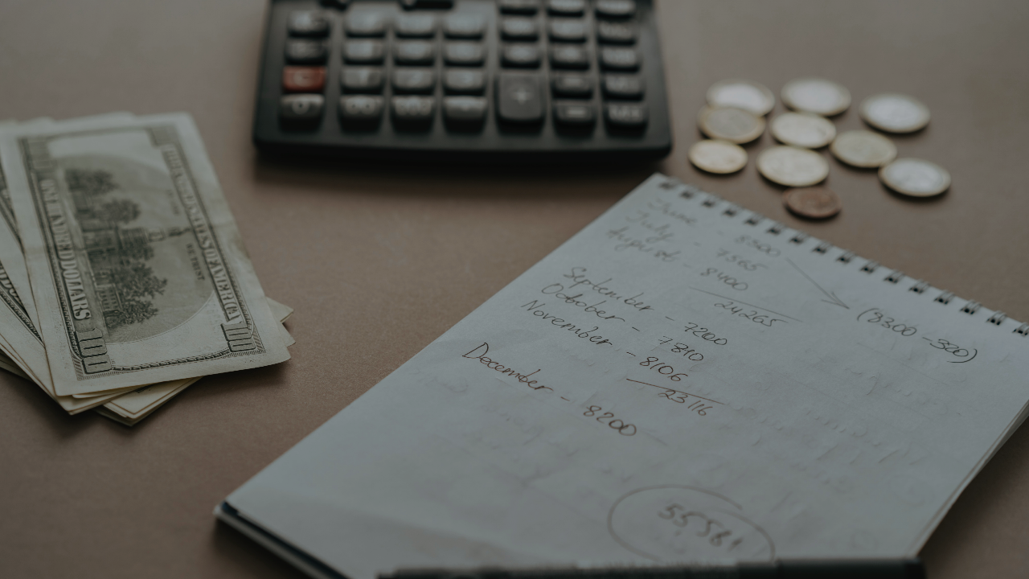

Budgetomatic
Dikshant Dwivedi – E19CSE194 | Kshitij Kumar – E19CSE146 | Pranjali Jain – E19CSE114
EB04

Slide 2

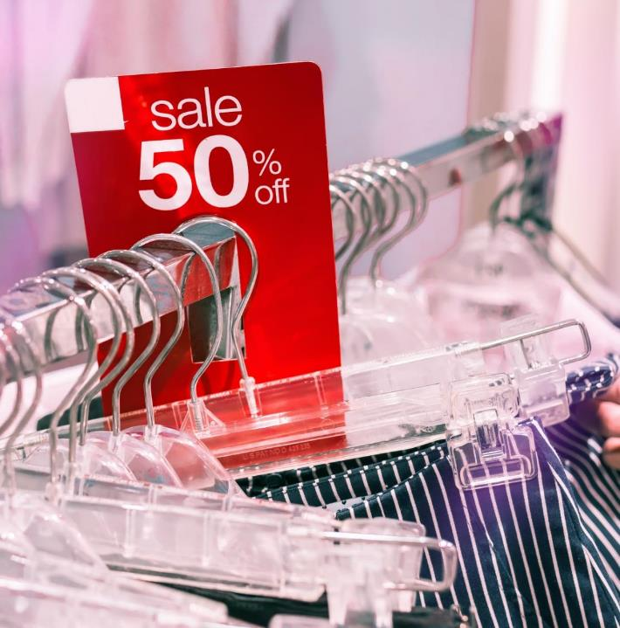
Introduction
In today’s service and consumer driven economy, it’s very tempting not to go overboard on purchases. There are tons of services and commodities to choose from and spending by millennials is only getting higher.

Slide 3

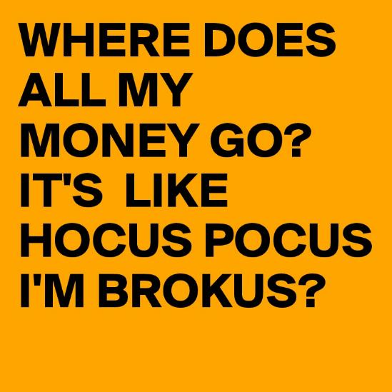
With that it becomes highly essential for one to track their spending.
Tracking expenditure makes one aware of where their money is being over spent, and how it could be managed more wisely to avoid a nasty financial situation and maintain a solid budget.

Slide 4
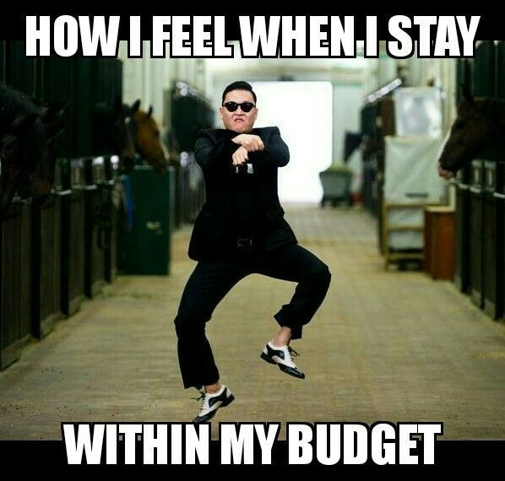
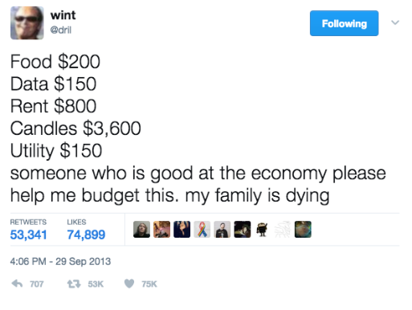
With this project, we aim to simplify personal expenditure tracking and analysis, so that one can save money for better purposes.

Slide 5

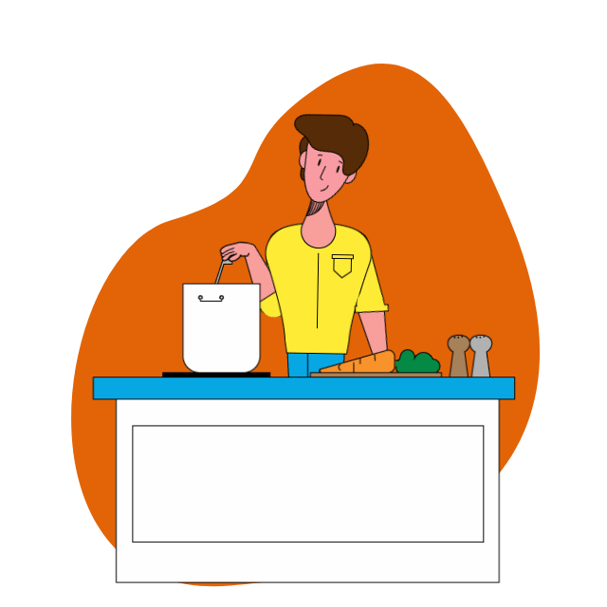
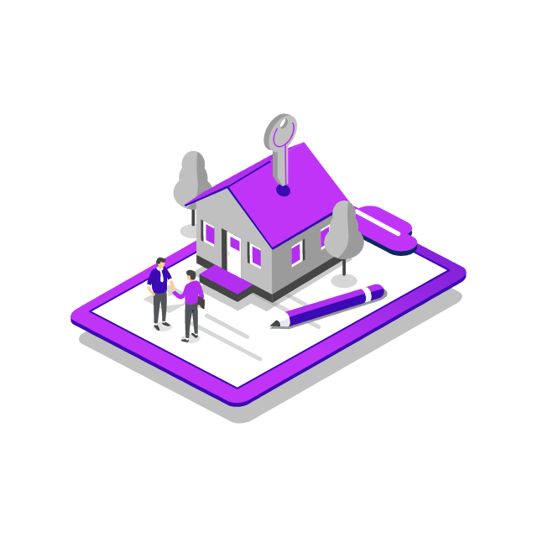



Problem
Imagine being an bachelor living in rented apartment in Bangalore and working in a hectic corporate environment

Slide 6
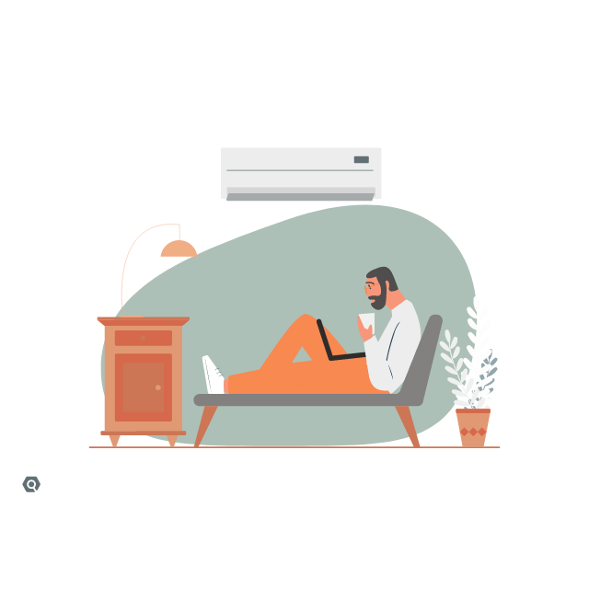



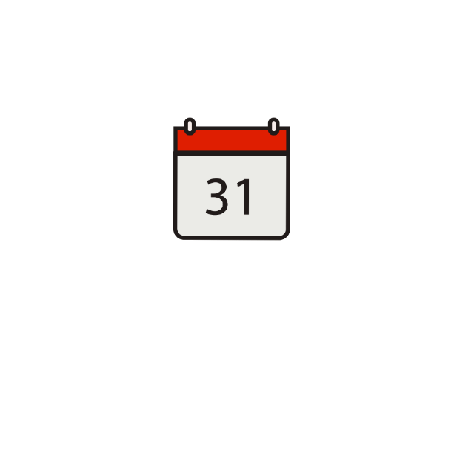
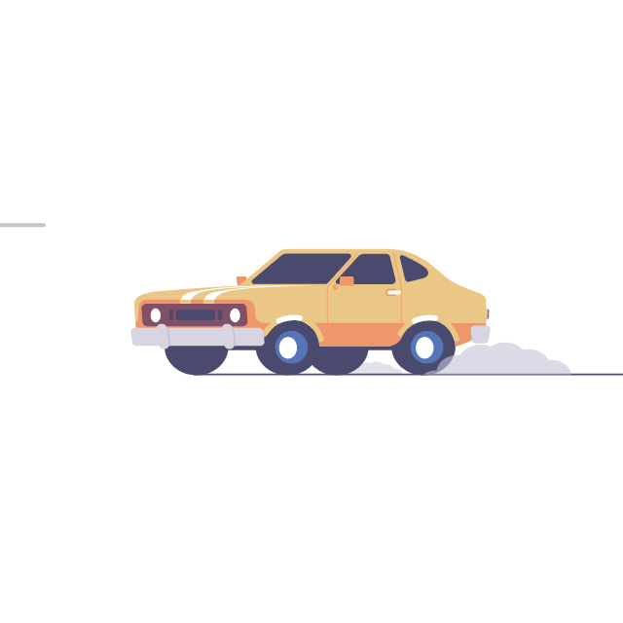
You might be someone running a household

Slide 7
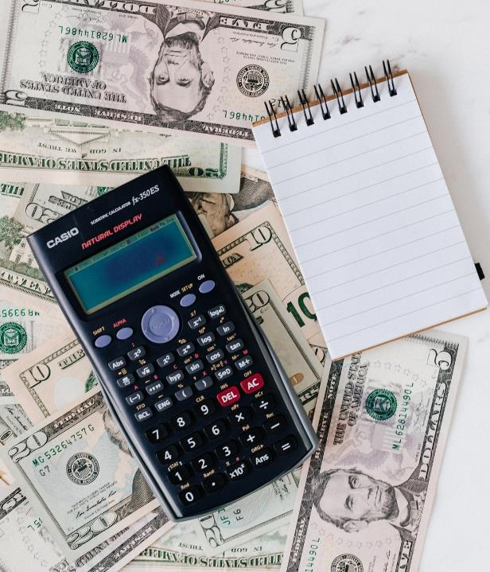
There are so many expenses to keep track of :
Salary management of manual helpers
Subscription services
Utilities like water and electricity bill
Personal maintenance
Lodging
Daily expenses
One time expenses
EMIs/insurances
Its so easy to get messy. As a result, the expenditure analysis gets more complex.

Slide 8
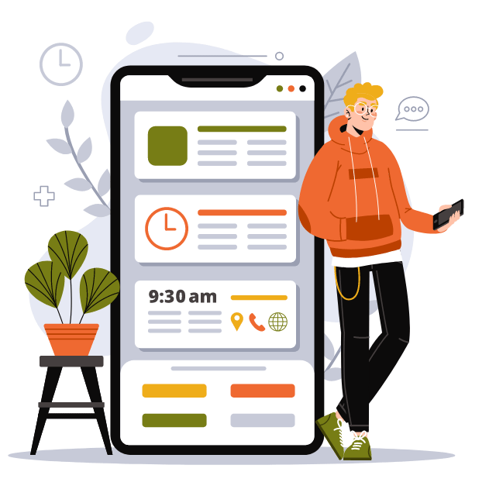
Solution:
The idea is to bring all different kind of expenses under one app-based digital platform making it possible to keep a record of every purchase, whether it is a service, commodity, utility or lodging.

Slide 9
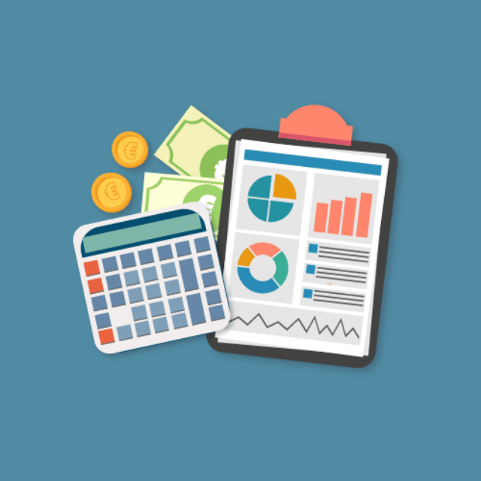
How does the solution innovative?
provides a pre-planned architecture for entering the expenses in a categorical manner. It then eases the whole process for user by generating complete analysis of expenditure based on the information entered.
Is it doable in the given time frame?
The idea is simple and doesn’t require any extensive research or technological resources which is the implementation of this project is doable in given time frame.

Slide 10




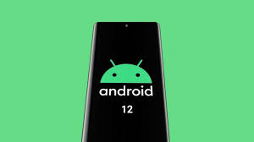

Project resources
A database cluster provided by the mongo dB for trial basis.
Node JS for JavaScript backend development.
Android studio for developing android application.
4 windows 10 workstations with VS Code and android studio for developing the android version of the software.
An Android phone to be used as test hardware for the mobile version of the software.
Kotlin, official language appointed by google for android app development.

Slide 11


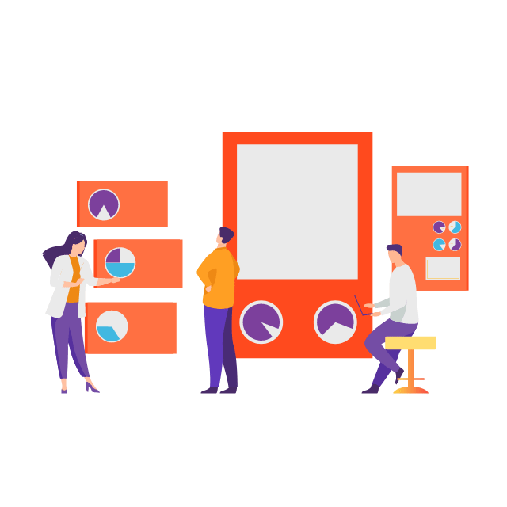
Users and Roles
Developers - A capstone team who is tasked with managing the front and backend, and for generating a firm process for applying these techniques to future user data.
Researchers - A team of researchers for developing new methods and procuring already established methods for improved and effective expenditure analysis and organization model.
End user - End user of the product who will be reaping the potential benefits from the expenditure analysis generated from the product.

Slide 12



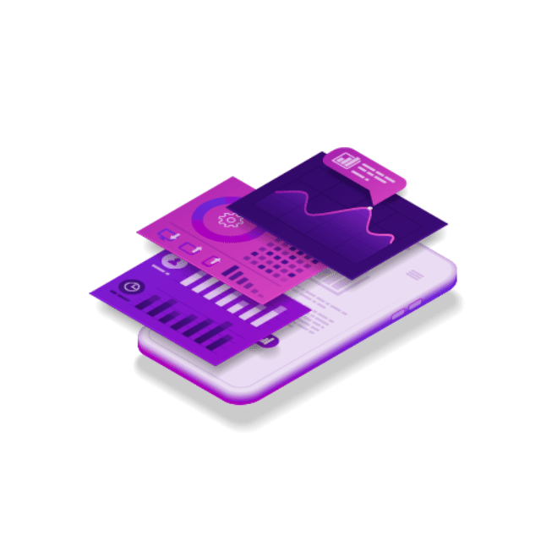
Software requirements
Enter all your expenses in an organized manner based on categories like manual helpers, personal maintenance, due dates and other one-time expenses.
Get alerts/reminders of due dates of any upcoming bills, subscription renewals, EMI dates, rents, fees, etc.
Based on the user fed information, get timely analysis of expenditure and income distributions along with savings to identify where you went overboard on your purchase.
Maintain daily attendance records of household and other labor helpers like cook, maid, driver, washerman, gardener etc.

Slide 13
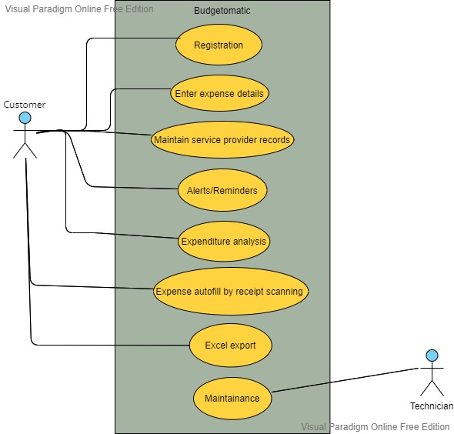
Use-case diagram

Slide 14
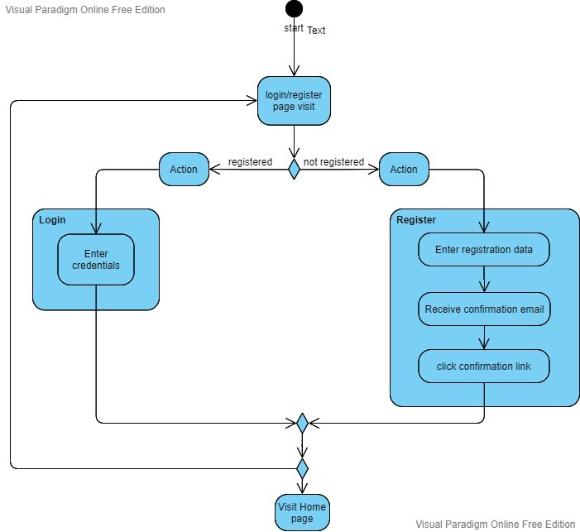
Activity diagram

Slide 15
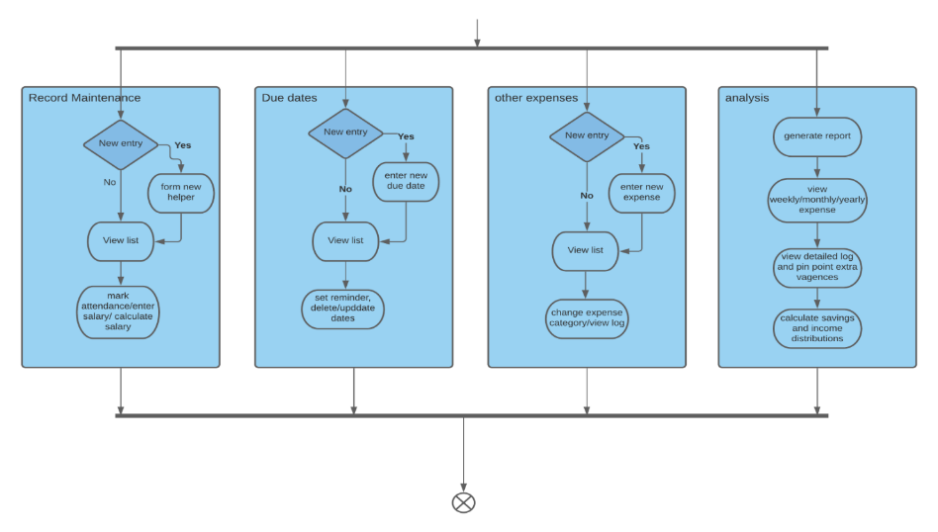
Activity diagram continued

Slide 16
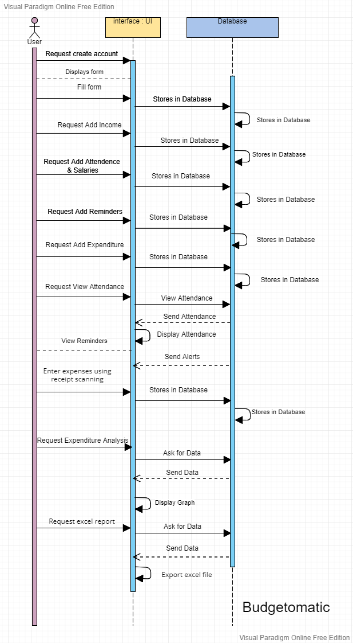
Sequence diagram

Slide 17
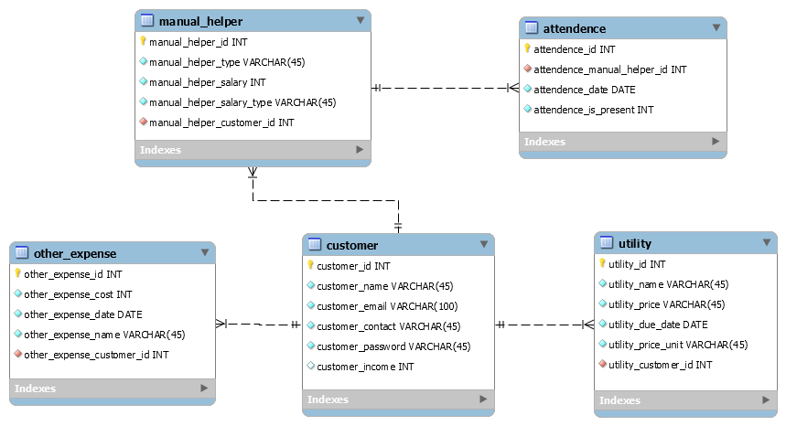
Data architecture diagram

Slide 18
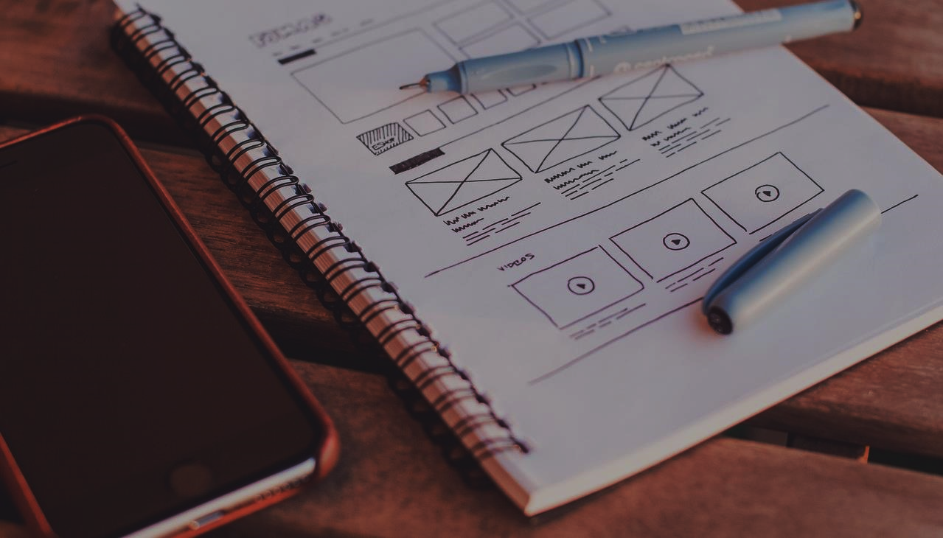
UI Mockups

Slide 19
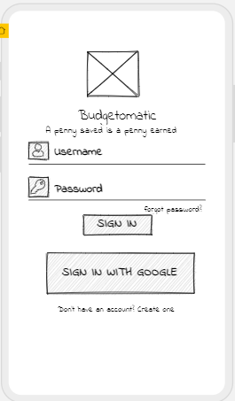
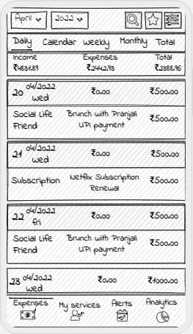
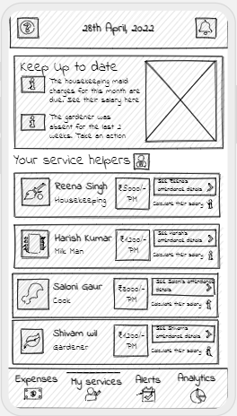

Slide 20
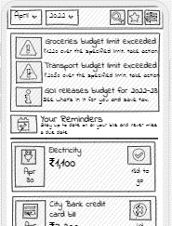
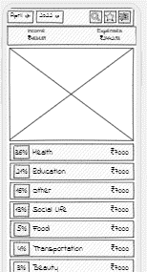
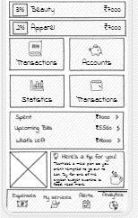
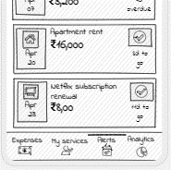

Slide 21
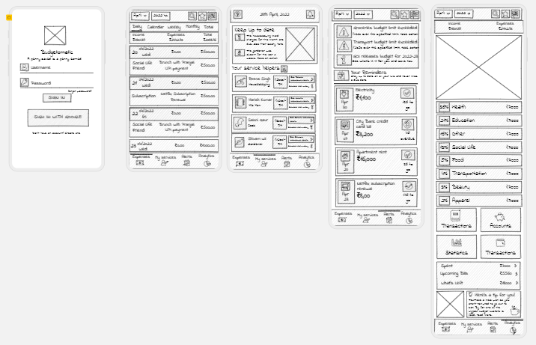

Slide 22
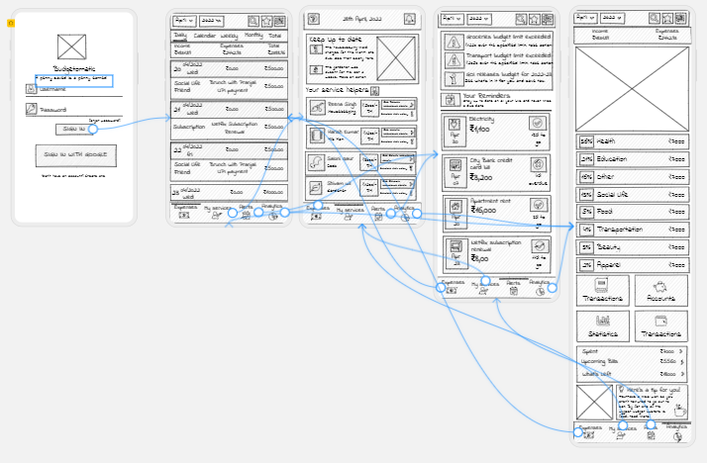

Slide 23


Feedback
“I really like the idea behind the project. As someone who is very careless with money and lazy about budgeting, I am extremely excited about Budgetomatic. I love that I will be able to auto scan receipts and keep attendance track of daily wager manual helpers. However, it would be helpful if the app is able to automatically detect online transactions.” - Mrinalini Bansal, Amazon
“I have a busy schedule and it's difficult for me to track my day to-day expenses. With your app it will become easy for me to keep an eye over all the purchases and dues. But everything here needs to be written and lack of time doesn't permit me to write every small expense. So, integration with Paytm and similar app would be a cherry on cake.” - Samarth Aggarwal, Cisco

Slide 24
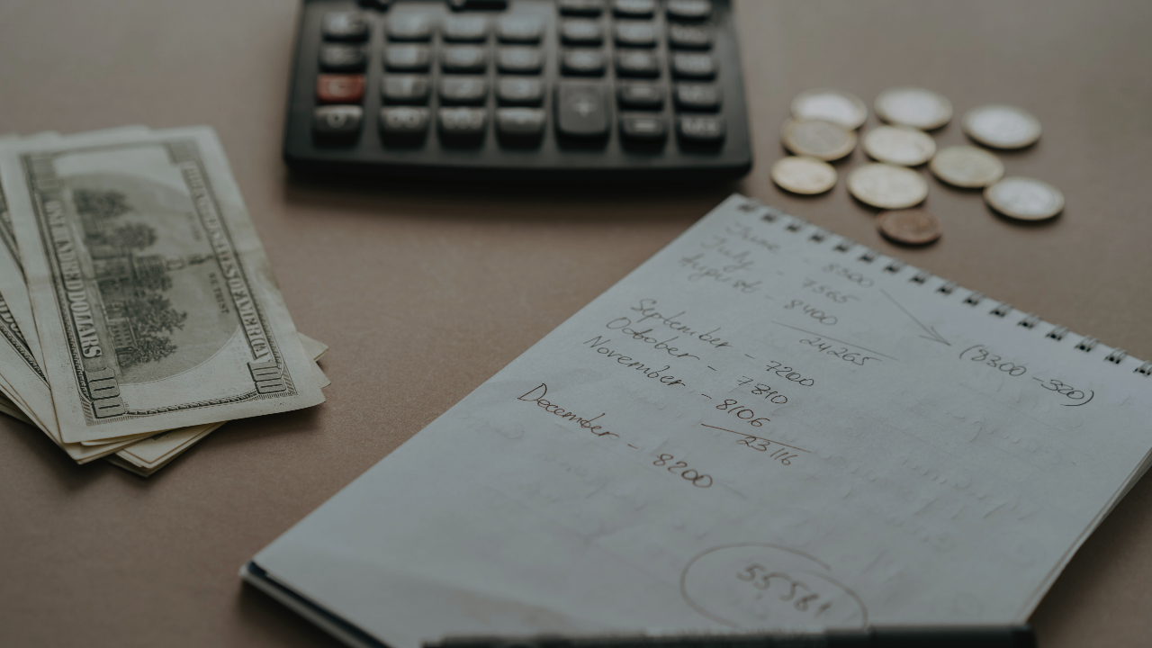

THANK YOU

